Slide 1
Go language
Anand Hariharan
Practice Head, Google

Slide 2
Module 14
Dependency management
godeps

Slide 3
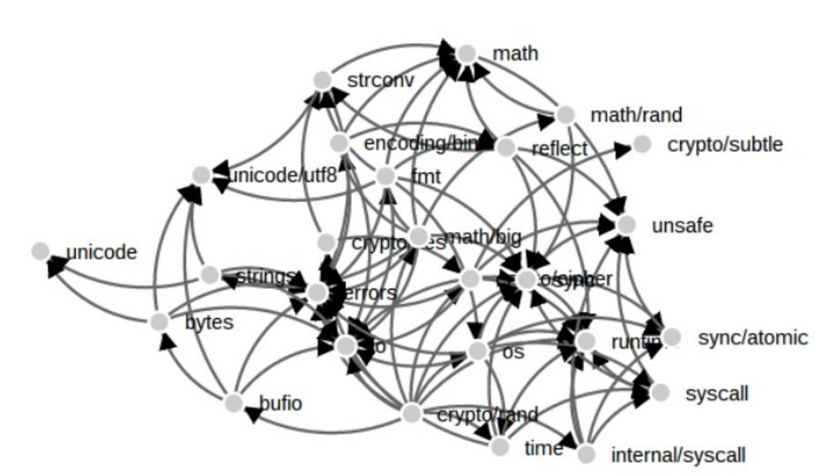
Why dependency management?
Dependencies: Some golang file which is needed to run another golang file
http://www.slideshare.net/ramitsurana/dependency-management-in-golang

Slide 4
godeps
One of the more popular tools for dependency management
Installing godeps
$ go get github.com/tools/godep
Using godeps
godep save
Exports all dependencies to a JSON file
save a list of dependencies to the file Godeps/Godeps.json and copy their source code into vendor/
Read over the contents of vendor/ and make sure it looks reasonable. Then commit the Godeps/ and vendor/ directories to version control.

Slide 5
godeps – common operations
The godep restore installs the package versions specified in Godeps/Godeps.json to your $GOPATH.
Edit-test Cycle
Edit code
Run godep go test
Add a Dependency
To add a new package foo/bar, do this:
Run go get foo/bar
Edit your code to import foo/bar.
Run godep save (or godep save ./...).
Update a Dependency
To update a package from your $GOPATH, do this:
Run go get -u foo/bar
Run godep update foo/bar. (You can use the ... wildcard, for example godep update foo/...).
Multiple Packages
If your repository has more than one package, run godep save ./... to capture the dependencies of all packages in your application.

Slide 6
Sample godeps file
{
"ImportPath": "github.com/kr/hk",
"GoVersion": "go1.6",
"Deps": [
{
"ImportPath": "code.google.com/p/go-netrc/netrc",
"Rev": "28676070ab99"
},
{
"ImportPath": "github.com/kr/binarydist",
"Rev": "3380ade90f8b0dfa3e363fd7d7e941fa857d0d13"
}
]
}

Slide 7
Anand Hariharan
Practice Head
anand.hariharan@wipro.com

